Slide 1

Air Humidity Temperature Monitoring System and Moisture Content in Maggot Cultivation
Final Project II – Group 11
Supervisor :
Eka Stephani Sinambela, SST., M.Sc

Slide 2



OUR GROUP MEMBERS
13321043 Louis Panggabean
13321045 Cindy Thresya S
13321059 Tasya Diva Aulia S

Slide 3
OUTLINES
01.
BACKGROUND
04.
02.
PURPOSE
03.
CURRENT SYSTEM
TARGET SYSTEM
05.
HARDWARE DESIGN
06.
DEMO

Slide 4
BACKGROUND
The background of making the system is :
Maggot breeders still use manual methods to maintain optimal temperature and humidity in the cage.
Waste reduction by cultivating maggot

Slide 5
PURPOSE
A system designed to monitor air humidity temperature and moisture content in maggot cultivation
Ensuring the quality of the maggot environment remains optimal
Provide easy access and flexible monitoring for maggot farmers, so they can monitor the maggot cultivation environment anytime and anywhere.
01.
02.
03.

Slide 6
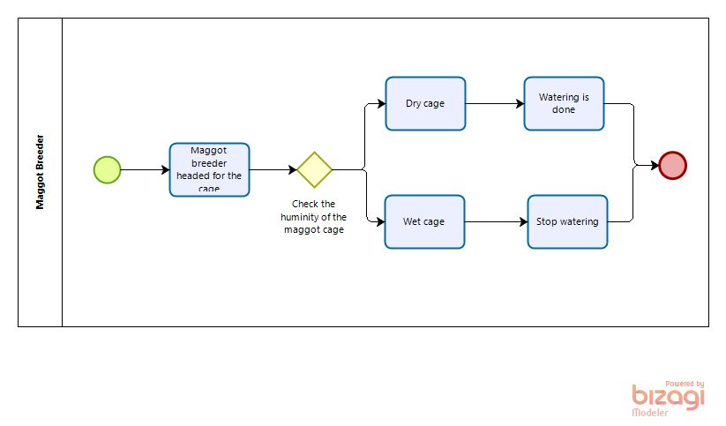
CURRENT SYSTEM

Slide 7
TARGET SYSTEM

Slide 8
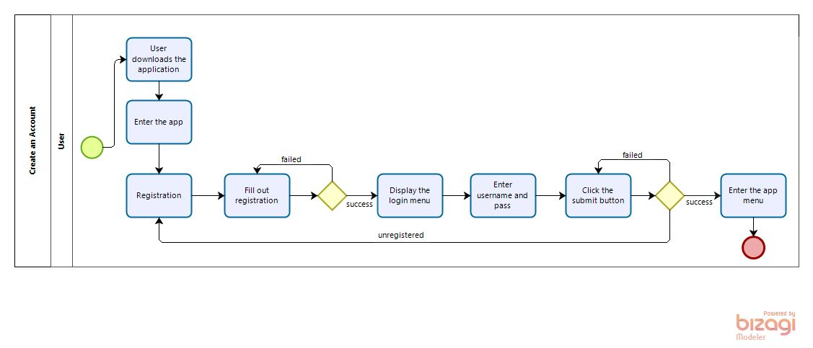
1. Business Process Registrasi dan Login

Slide 9
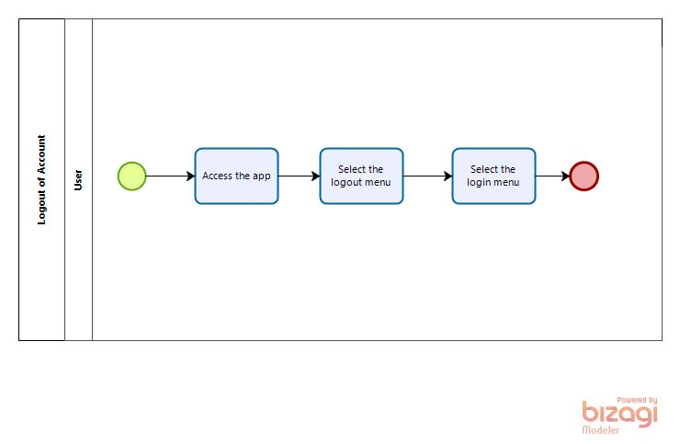
2. Log out Account

Slide 10
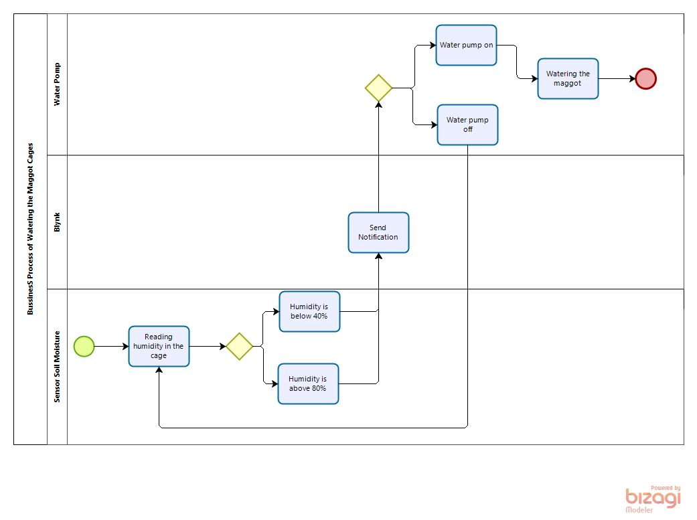
3. Business Process Sensor Soil Moisture

Slide 11
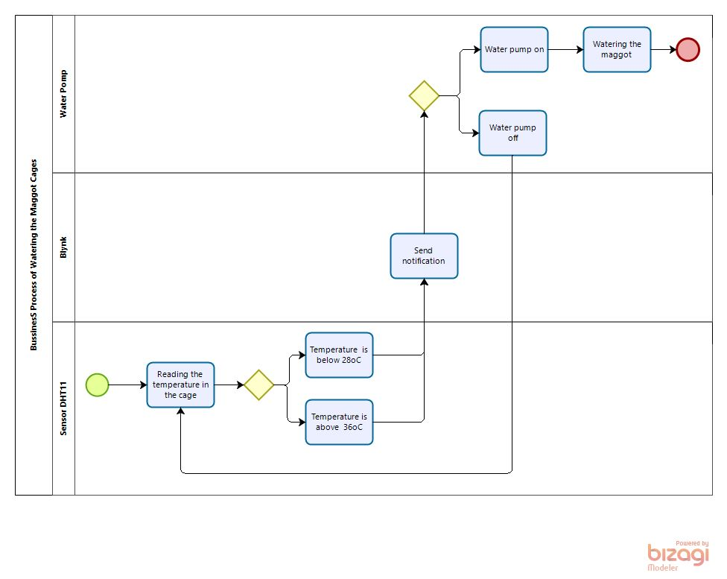
4. Business Process Sensor DHT 11

Slide 12
HARDWARE DESIGN

Slide 13
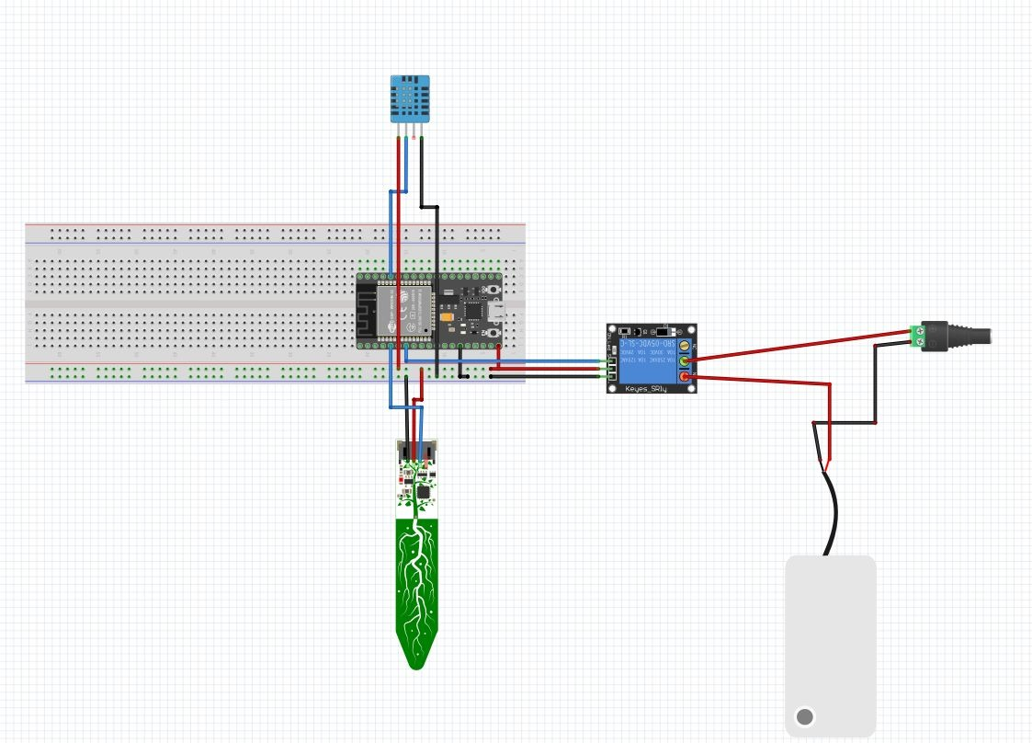

Slide 14
COMPONENTS
JUMPER CUBLES
ESP32
ADAPTER
DHT11
POMP WATER
BREADBOARD
SOIL MOISTURE
RELAY
LAPTOP

Slide 15
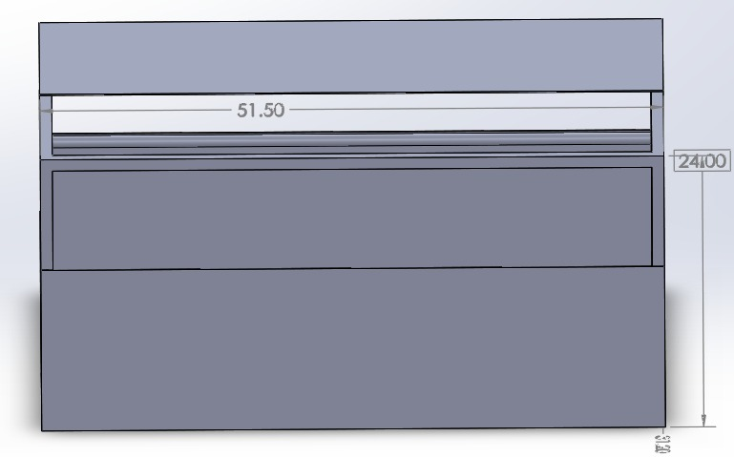
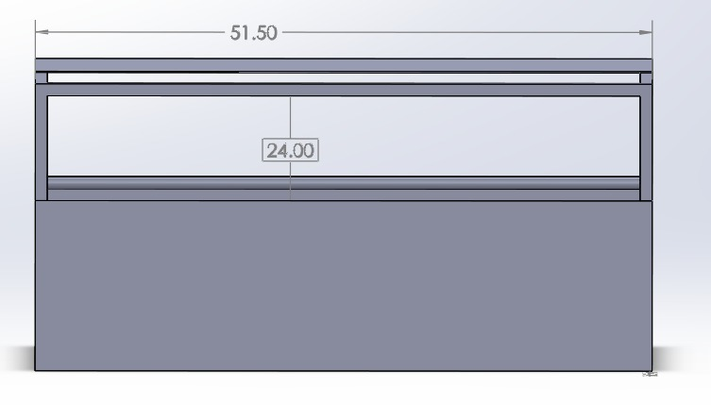
Front look
FRONT VIEW

Slide 16

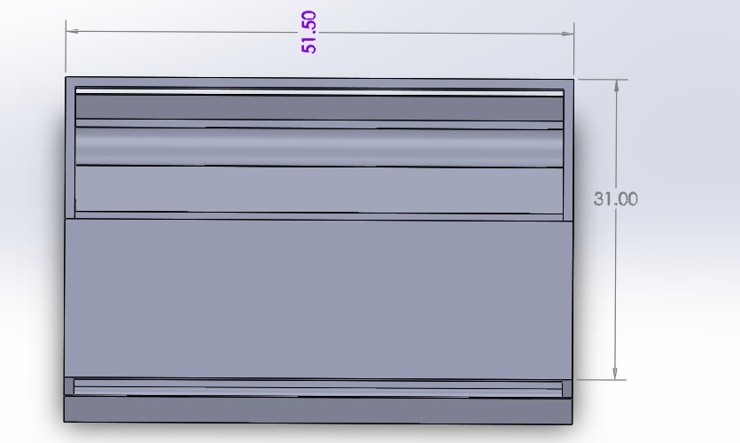
BACK VIEW
TOP VIEW

Slide 17


BOTTOM VIEW
SIDE VIEW

Slide 18
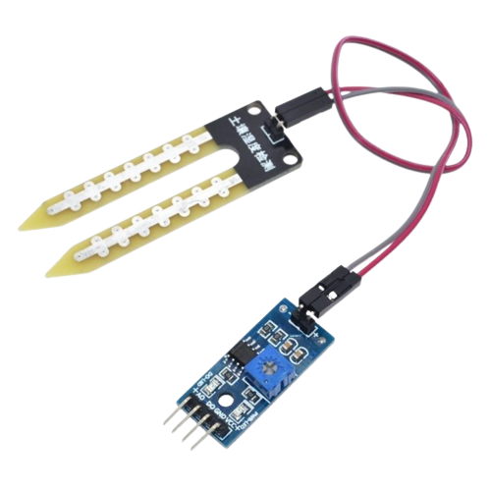


DEMO

Slide 19
THANK YOU

